Slide 1
pH
The numerical values of hydronium ion concentration may vary enormously; for a normal solution of a strong acid the value is nearly 1, whereas for a normal solution of a strong base it is approximately 1 × 10⁻¹⁴; there is a variation of 100,000,000,000,000 between these two limits. Because of the inconvenience of dealing with such large numbers, in 1909 Sørenson proposed that hydronium ion concentration be expressed in terms of the logarithm (log) of its reciprocal. To this value he assigned the symbol pH.

Slide 2
Mathematically this is written as
This equation can also be displayed as
as the logarithm of 1 is zero.

Slide 3
Thus the pH also may be defined as the negative logarithm of the hydronium ion concentration.
In general, this type of notation is used to indicate the negative logarithm of the term that is preceded by the p, which gives rise to the following
and similarly

Slide 4
This enables the pH of a solution to be considered on a numerical scale from 0–14 and is more convenient in terms of speech, writing and data manipulation. Acidic solutions having a predominance of [H₃O⁺] have pH values between 0 and 7. The hydroniumion concentration of pure water, at 25°C, is 1 × 10⁻⁷ N, corresponding to a pH of 7. This figure, therefore, is designated as the neutral point, and all values below a pH of 7 represent acidity–the smaller the number, the greater the acidity.

Slide 5
Values above 7 represent alkalinity–the larger the number, the greater the alkalinity.
Mathematically there is no reason why negative numbers or numbers above 14 should not be used. In practice, however, such values are never encountered because solutions that might be expected to have such values are too concentrated to be ionized extensively or the interionic attraction is so great as to materially reduce ionic activity.

Slide 6
The pH Scale and Corresponding Hydrogen and Hydroxyl Ion Concentrations

Slide 7
pH | [H₃O⁺] (moles/liter) | [OH⁻¹] (moles/liter)
0 | 10⁰ = 1 | 10⁻¹⁴
1 | 10⁻¹ | 10⁻¹³
2 | 10⁻² | 10⁻¹²
3 | 10⁻³ | 10⁻¹¹ | Acidic
4 | 10⁻⁴ | 10⁻¹⁰
5 | 10⁻⁵ | 10⁻⁹
6 | 10⁻⁶ | 10⁻⁸
7 | 10⁻⁷ | 10⁻⁷ | Neutral
8 | 10⁻⁸ | 10⁻⁶
9 | 10⁻⁹ | 10⁻⁵
10 | 10⁻¹⁰ | 10⁻⁴
11 | 10⁻¹¹ | 10⁻³ | Basic
12 | 10⁻¹² | 10⁻²
13 | 10⁻¹³ | 10⁻¹
14 | 10⁻¹⁴ | 10⁰ = 1

Slide 8
A better definition of pH involves the activity rather than the concentration of the ions:
pH= -log a_{H}⁺
and because the activity of an ion is equal to the activity coefficient multiplied by the molal or molar concentration.
Hydrogen ion concentration x activity coefficient = hydronium ion activity

Slide 9
the pH may be computed more accurately from the formula
pH= -log (γ x c)
Hence, the addition of a neutral salt affects the hydrogen ion activity of a solution, and activity coefficients should be used for the accurate calculation of pH.
For practical purposes, activities and concentrations are equal in solutions of weak electrolytes to which no salts are added, because the ionic strength is small.

Slide 10
Significance of pH

Slide 14
Buffers
Buffers are compounds or mixtures of compounds that, by their presence in solution, resist changes in pH upon the addition of small quantities of acid or alkali. The resistance to a change in pH is known as buffer action.

Slide 15
A mixture of a weak acid HA and its ionised salt (for example, NaA) acts as a buffer because the A⁻ ions from the salt combine with the added H⁺ ions, removing them from solution as undissociated weak acid:
Added OH⁻ ions are removed by combination with the weak acid to form undissociated water molecules:

Slide 16
A mixture of a weak base and its salt acts as a buffer because added H⁺ ions are removed by the base B to form the salt and OH⁻ ions are removed by the salt to form undissociated water:

Slide 17
The mechanism of action of the acetic acid–sodium acetate buffer pair is that the acid, which exists largely in molecular (nonionized) form, combines with hydroxyl ion that may be added to form acetate ion and water; thus,
The acetate ion, which is a base, combines with the hydrogen (or more exactly hydronium) ion that may be added to form essentially nonionized acetic acid and water, represented as

Slide 18
The change of pH is slight as long as the amount of hydronium or hydroxyl ion added does not exceed the capacity of the buffer system to neutralize it.

Slide 19
The buffer equation, common ion effect and the buffer equation for a weak acid and its salt
The pH of a buffer solution and the change in pH upon the addition of an acid or base can be calculated by use of the buffer equation. This expression is developed by considering the effect of a salt on the ionization of a weak acid when the salt and the acid have an ion in common.

Slide 20
When sodium acetate is added to acetic acid, the dissociation constant for the weak acid, is momentarily disturbed because the acetate ion supplied by the salt increases the [Ac⁻] term in the numerator. To reestablish the constant Ka, the hydrogen ion term in the numerator [H₃0⁺] is instantaneously decreased, with a corresponding increase in [HAc]. Therefore, the constant Ka remains unaltered, and the equilibrium is shifted in the direction of the reactants.

Slide 21
Consequently, the ionization of acetic acid,
is repressed upon the addition of the common ion, Ac⁻. This is an example of the common ion effect.
The pH of the final solution is obtained by rearranging the equilibrium expression for acetic acid:

Slide 22
If the acid is weak and ionizes only slightly, the expression [HAc] may be considered to represent the total concentration of acid, and it is written simply as [Acid]. In the slightly ionized acidic solution, the acetate concentration [Ac⁻] can be considered as having come entirely from the salt, sodium acetate. Because 1 mole of sodium acetate yields 1 mole of acetate ion, [Ac-] is equal to the total salt concentration and is replaced by the term [Salt]. Hence, the above equation is written as

Slide 23
This equation can be expressed in logarithmic form, with the signs reversed, as
from which is obtained an expression, known as the buffer equation or the Henderson–Hasselbalch equation, for a weak acid and its salt:
The buffer equation is important in the preparation of buffered pharmaceutical solutions.

Slide 24
The Henderson Hasselbalch equation is useful also for calculating the ratio of molar concentrations of a buffer system required to produce a solution of specific pH.

Slide 25
The buffer equation for a weak base and its salt
Buffer solutions are not ordinarily prepared from weak bases and their salts because of the volatility and instability of the bases and because of the dependence of their pH on pK_{w} , which is often affected by temperature changes.
Pharmaceutical solutions—for example, a solution of ephedrine base and ephedrine hydrochloride—however, often contain combinations of weak bases and their salts.
The buffer equation for solutions of weak bases and the corresponding salts can be derived in a manner analogous to that for the weak acid buffers. Accordingly

Slide 26
As
[OH⁻] + [H₃0⁺] = K_{w}
[OH⁻] = K_{W}/[H₃0⁺]

Slide 27
Putting the value of [OH⁻] in the above equation and by rearranging it

Slide 28
Activity coefficients and the buffer equation
A more exact treatment of buffers begins with the replacement of concentrations by activities in the equilibrium of a weak acid:
The activity of each species is written as the activity coefficient multiplied by the molar concentration.

Slide 29
The activity coefficient (activity/conc.) of the undissociated acid, γHAc, is essentially 1 and may be dropped. Solving for the hydrogen ion activity and pH, defined as
-log aH₃O⁺, yields the equations

Slide 30
Some factors influencing the pH of buffer solutions
The addition of neutral salts to buffers changes the pH of the solution by altering the ionic strength.
Changes in ionic strength and hence in the pH of a buffer solution can also be brought about by dilution. The addition of water in moderate amounts, although not changing the pH, may cause a small positive or negative deviation because it alters activity coefficients and because water itself can act as a weak acid or base.

Slide 31
The change in pH on diluting the buffer solution to one half of its original strength is called dilution value. A positive dilution value signifies that the pH rises with dilution and a negative value signifies that the pH decreases with dilution of the buffer.

Slide 32
Temperature also influences buffers
The change in pH with temperature is referred to as the temperature coefficient of pH. The pH of acetate buffers was found to increase with temperature, whereas the pH of boric acid–sodium borate buffers decreased with temperature.
Although the temperature coefficient of acid buffers was relatively small, the pH of most basic buffers was found to change more markedly with temperature, owing to Kw, which appears in the equation of basic buffers and changes significantly with temperature.

Slide 33
Drugs as Buffers
It is important to recognize that solutions of drugs that are weak electrolytes also manifest buffer action. Salicylic acid solution in a soft glass bottle is influenced by the alkalinity of the glass. It might be thought at first that the reaction would result in an appreciable increase in pH; however, the sodium ions of the soft glass combine with the salicylate ions to form sodium salicylate. Thus, there arises a solution of salicylic acid and sodium salicylate—a buffer solution that resists the change in pH.

Slide 34
Similarly, a solution of ephedrine base manifests a natural buffer protection against reductions in pH. Should hydrochloric acid be added to the solution, ephedrine hydrochloride is formed, and the buffer system of ephedrine plus ephedrine hydrochloride will resist large changes in pH until the ephedrine is depleted by reaction with the acid. Therefore, a drug in solution may often act as its own buffer over a definite pH range.

Slide 35
Such buffer action, however, is often too weak to counteract pH changes brought about by the carbon dioxide of the air and the alkalinity of the bottle. Additional buffers are therefore frequently added to drug solutions to maintain the system within a certain pH range.

Slide 36
pH Indicators
Indicators may be considered as weak acids or weak bases that act like buffers and also exhibit color changes as their degree of dissociation varies with pH. For example, methyl red shows its full alkaline color, yellow, at a pH of about 6 and its full acid color, red, at about pH 4.
The dissociation of an acid indicator is given in simplified form as

Slide 37
The equilibrium expression is
The equilibrium expression can be treated in a manner similar to that for a buffer consisting of a weak acid and its salt or conjugate base. Hence

Slide 38
and because [HIn] represents the acid color of the indicator and the conjugate base [In⁻] represents the basic color, these terms can be replaced by the concentration expressions [Acid] and [Base]. The formula for pH as derived from equation becomes

Slide 39
Just as a buffer shows its greatest efficiency when pH = pKa, an indicator exhibits its middle tint when [Base]/[Acid] = 1 and pH = pK_{In}. The most efficient indicator range, corresponding to the effective buffer interval, is about 2 pH units, that is, pK_{In} ± 1.
The reason for the width of this color range can be explained as follows.
It is known from experience that one cannot discern a change from the acid color to the salt or conjugate base color until the ratio of [Base] to [Acid] is about 1 to 10.

Slide 40
That is, there must be at least 1 part of the basic color to 10 parts of the acid color before the eye can discern a change in color from acid to alkaline. The pH value at which this change is perceived is given by the equation.
Conversely, the eye cannot discern a change from the alkaline to the acid color until the ratio of [Base] to [Acid] is about 10 to 1, or

Slide 41
Therefore, when base is added to a solution of a buffer in its acid form, the eye first visualizes a change in color at pK_{In} - 1, and the color ceases to change any further at pK_{In} + 1. The effective range of the indicator between its full acid and full basic color can thus be expressed as

Slide 42
Chemical indicators are typically compounds with chromophores (an atom or group whose presence is responsible for the colour of a compound) that can be detected in the visible range and change color in response to a solution's pH. Most chemicals used as indicators respond only to a narrow pH range.
Several indicators can be combined to yield so-called universal indicators just as buffers can be mixed to cover a wide pH range.
A universal indicator is a pH indicator that displays different colors as the pH transitions from pH 1 to 12. A typical universal indicator will display a color range from red to purple.

Slide 43
For example, a strong acid (pH 0–3) may display as red in color, an acid (pH 3–6) as orange–yellow, neutral pH (pH 7) as green, alkaline pH (pH 8–11) as blue, and purple for strong alkaline pH (pH 11–14).

Slide 44
Some common indicators
 | Color
Indicator | Acid | Base | pH range | pK_{In}
Thymol blue (acid range) | Red | Yellow | 1.2–2.8 | 1.5
Methyl violet | Blue | Violet | 1.5–3.2 | -
Methyl orange | Red | Yellow | 3.1–4.4 | 3.7
Bromcresol green | Yellow | Blue | 3.8–5.4 | 4.7
Methyl red | Red | Yellow | 4.2–6.2 | 5.1
Bromcresol purple | Yellow | Purple | 5.2–6.8 | 6.3
Bromthymol blue | Yellow | Blue | 6.0–7.6 | 7.0
Phenol red | Yellow | Red | 6.8–8.4 | 7.9
Cresol red | Yellow | Red | 7.2–8.8 | 8.3
Thymol blue (alkaline range) | Yellow | Blue | 8.0-9.6 | 8.9
Phenolphthalein | Colorless | Red | 8.3–10.0 | 9.4
Alizarin yellow | Yellow | Lilac (light blue) | 10.0– 12.0 | -
Indigo carmine | Blue | Blue | 11.6–14 | -

Slide 45
Buffer capacity
The magnitude of the resistance of a buffer to pH changes is referred to as the buffer capacity, β. It is also known as buffer efficiency, buffer index, and buffer value.
Buffer capacity can also be defined “as the ratio of the increment of strong base (or acid) to the small change in pH brought about by this addition”.

Slide 46
In which delta, Δ, has its usual meaning, a finite change, and ΔB is the small increment in gram equivalents (g Eq)/liter of strong base added to the buffer solution to produce a pH change of ΔpH. According to the above equation, the buffer capacity of a solution has a value of 1 when the addition of 1 g Eq of strong base (or acid) to 1 liter of the buffer solution results in a change of 1 pH unit.
Gram equivalent: the atomic or molecular weight divided by the valence.

Slide 47
The buffer has its greatest capacity before any base is added, where [Salt]/[Acid] = 1, and, therefore, according to equation, pH = pKa.
The buffer capacity is also influenced by an increase in the total concentration of the buffer constituents because, obviously, a great concentration of salt and acid provides a greater alkaline and acid reserve.

Slide 48
A more exact equation for buffer capacity
The buffer capacity calculated from the following equation is only approximate.
It gives the average buffer capacity over the increment of base added. Koppel and Spirol and Van developed a more exact equation,

Slide 49
where C is the total buffer concentration, that is, the sum of the molar concentrations of the acid and the salt. This equation permits one to compute the buffer capacity at any hydrogen ion concentration—for example, at the point where no acid or base has been added to the buffer.

Slide 50
Maximum buffer capacity
An equation expressing the maximum buffer capacity can be derived from the buffer capacity formula of Koppel and Spirol and Van equation. The maximum buffer capacity occurs where pH = pKa, or, in equivalent terms, where [H₃O⁺] = Ka. Substituting [H₃O⁺] for Ka in both the numerator and the denominator of the equation gives
where C is the total buffer concentration

Slide 51
Pharmaceutical buffers
Buffer solutions are used frequently in pharmaceutical practice, particularly in the formulation of ophthalmic solutions. They also find application in the colorimetric determination (a method of determining the concentration of a chemical element or chemical compound in a solution with the aid of a color reagent) of pH and for research studies in which pH must be held constant.
Gifford suggested two stock solutions, one containing boric acid and the other monohydrated sodium carbonate, which, when mixed in various proportions, yield buffer solutions with pH values from about 5 to 9.

Slide 52
Sorensen proposed a mixture of the salts of sodium phosphate for buffer solutions of pH 6 to 8. Sodium chloride is added to each buffer mixture to make it isotonic with body fluids.
A buffer system suggested by Palitzsch and modified by Hind and Goyan consists of boric acid, sodium borate, and sufficient sodium chloride to make the mixtures isotonic. It is used for ophthalmic solutions in the pH range of 7 to 9.

Slide 53
Buffers suggested by Clark–Lubs, and their corresponding pH ranges are as follows:
HCl and KCl, pH 1.2 to 2.2
HCl and potassium hydrogen phthalate, pH 2.2 to 4.0
NaOH and potassium hydrogen phthalate, pH 4.2 to 5.8
NaOH and KH₂PO₄, pH 5.8 to 8.0
H₃BO₃, NaOH, and KCl, pH 8.0 to 10.0

Slide 54
Buffered isotonic solutions
In addition to carrying out pH adjustment, pharmaceutical solutions that are meant for application to delicate membranes of the body should also be adjusted to approximately the same osmotic pressure as that of the body fluids.
Isotonic solutions cause no swelling or contraction of the tissues with which they come in contact and produce no discomfort when instilled in the eye, nasal tract, blood, or other body tissues. Isotonic sodium chloride is a familiar pharmaceutical example of such a preparation.

Slide 55
An isotonic solution is one that exhibits the same effective osmotic pressure as blood serum, whereas hypotonic and hypertonic solutions refer to solutions in which the osmotic pressure exerted by the solution is less than and greater than blood serum, respectively.
Osmotic pressure: the pressure that would have to be applied to a pure solvent to prevent it from passing into a given solution by osmosis, often used to express the concentration of the solution.

Slide 56
The need to achieve isotonic conditions with solutions to be applied to delicate membranes is dramatically illustrated by mixing a small quantity of blood with aqueous sodium chloride solutions of varying tonicity.
For example, if a small quantity of blood, defibrinated to prevent clotting, is mixed with a solution containing 0.9 g of NaCl per 100 mL, the cells retain their normal size. The solution has essentially the same salt concentration and hence the same osmotic pressure as the red blood cell contents and is said to be isotonic with blood.

Slide 57
If the red blood cells are suspended in a 2.0% NaCl solution, the water within the cells passes through the cell membrane in an attempt to dilute the surrounding salt solution until the salt concentrations on both sides of the erythrocyte membrane are identical. This outward passage of water causes the cells to shrink and become wrinkled or crenated. The salt solution in this instance is said to be hypertonic with respect to the blood cell contents.

Slide 58
Finally, if the blood is mixed with 0.2% NaCl solution or with distilled water, water enters the blood cells, causing them to swell and finally burst, with the liberation of hemoglobin. This phenomenon is known as hemolysis, and the weak salt solution or water is said to be hypotonic with respect to the blood.

Slide 59
It is noted that the red blood cell membrane is not impermeable to all drugs; that is, it is not a perfect semipermeable membrane. Thus, it will permit the passage of not only water molecules but also solutes such as urea, ammonium chloride, alcohol, and boric acid.
A 2.0% solution of boric acid has the same osmotic pressure as the blood cell contents and is therefore said to be isosmotic with blood. The molecules of boric acid pass freely through the erythrocyte membrane, regardless of concentration.

Slide 60
As a result, this solution acts essentially as water when in contact with blood cells. Because it is extremely hypotonic with respect to the blood, boric acid solution brings about rapid hemolysis. Therefore, a solution containing a quantity of drug calculated to be isosmotic with blood is isotonic only when the blood cells are impermeable to the solute molecules and permeable to the solvent, water. It is interesting to note that the mucous lining of the eye acts as a true semipermeable membrane to boric acid in solution. Accordingly, a 2.0% boric acid solution serves as an isotonic ophthalmic preparation.

Slide 61
Applications of isotonic solutions
Ophthalmic medication
It is generally accepted that ophthalmic preparations intended for instillation into the cul-de-sac of the eye should be approximately isotonic to avoid irritation. It also has been stated that the abnormal tonicity of contact lens solutions can cause the lens to adhere to the eye and/or cause burning or dryness and photophobia.

Slide 62
Neonatal enteral and total peripheral medication
Because of the different fluid and protein requirements of neonates and pediatric patients, the final concentration of glucose and amino acids are often different from those of an adult. Therefore, care should be taken to render them isotonic with the body fluids.

Slide 63
Hyperosmotic agents
Therapies directly applying osmotic gradients therapeutically are few.
Upon nebulization of these solutions, water movement is increased through the lungs’ transepithelial surface to dilute any mucus volume. Higher osmolarities produce transepithelial movement through tight junctions, further accelerating tracheobronchial mucocillary clearance.

Slide 64
Parenteral medication
Solutions that differ from the serum in tonicity generally cause tissue irritation, pain on injection, and electrolyte shifts etc.
Excessive infusion of hypotonic fluids may cause swelling of red blood cells, hemolysis, and water invasion of the body’s cells in general.
Excessive infusion of hypertonic fluids leads to a wide variety of complications. For example, hyperglycemia, osmotic diuresis, loss of water and electrolytes, dehydration, and coma.
Therefore, parenteral medication needs to isotonic with the body fluids to avoid such complications.

Slide 65
Methods of adjusting tonicity
There are several methods for adjusting the tonicity of an aqueous solution, provided, of course, that the solution is hypotonic when the drug and additives are dissolved. The most prominent of these methods are the freezing-point depression method, the sodium chloride equivalent method, and the isotonic solution V-value method. The first two of these methods can be used with a three-step problem-solving process, based on sodium chloride.

Slide 66
Identify a reference solution and the associated tonicity parameter.
Determine the contribution of the drug(s) and additive(s) to the total tonicity.
Determine the amount of sodium chloride needed by subtracting the contribution of the actual solution from the reference solution.

Slide 67
Freezing-point–depression method
The freezing-point method makes use of a D value.
The reference solution for the freezing-point-depression method is 0.9% sodium chloride, which has a freezing-point depression of ΔTf = 0.52°.
Using the three steps described above, the dexamethasone sodium phosphate solution in the following example can be rendered isotonic as follows:

Slide 68
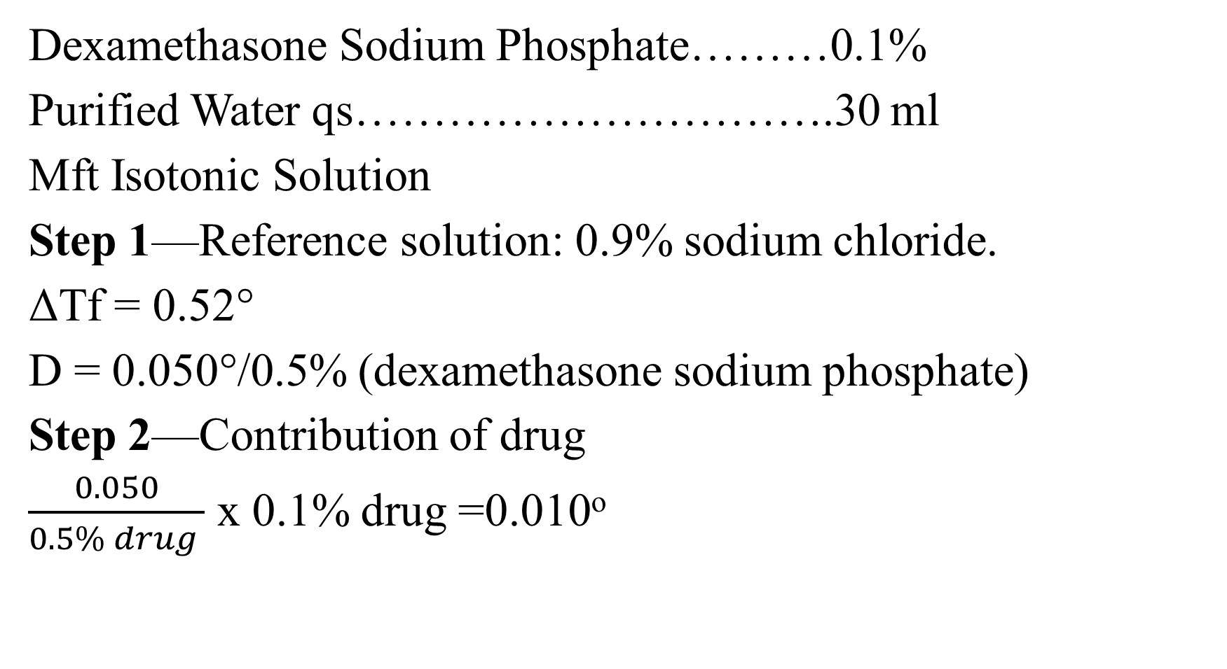
Dexamethasone Sodium Phosphate………0.1%
Purified Water qs………………………….30 ml
Mft Isotonic Solution
Step 1—Reference solution: 0.9% sodium chloride.
ΔTf = 0.52°
D = 0.050°/0.5% (dexamethasone sodium phosphate)
Step 2—Contribution of drug
$\frac{0.050}{0.5\% drug }$ x 0.1% drug =0.010º

Slide 69
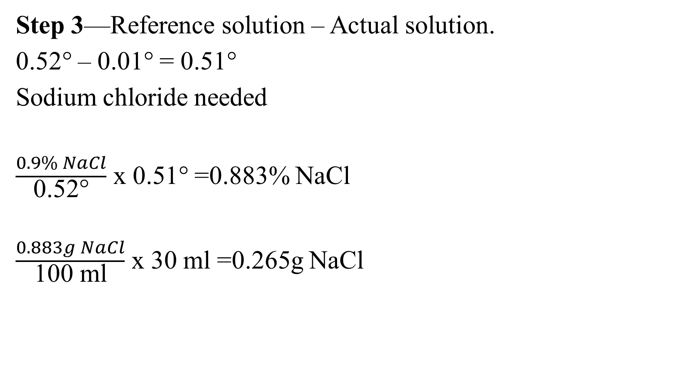
Step 3—Reference solution – Actual solution.
0.52° – 0.01° = 0.51°
Sodium chloride needed
$\frac{0.9\% NaCl}{\text{0.52°}}$ x $\text{0.5}\text{1}\text{°}$ =0.883% NaCl
$\frac{0.883g NaCl}{\text{100 }\text{ml}}$ x 30 ml =0.265g NaCl

Slide 70
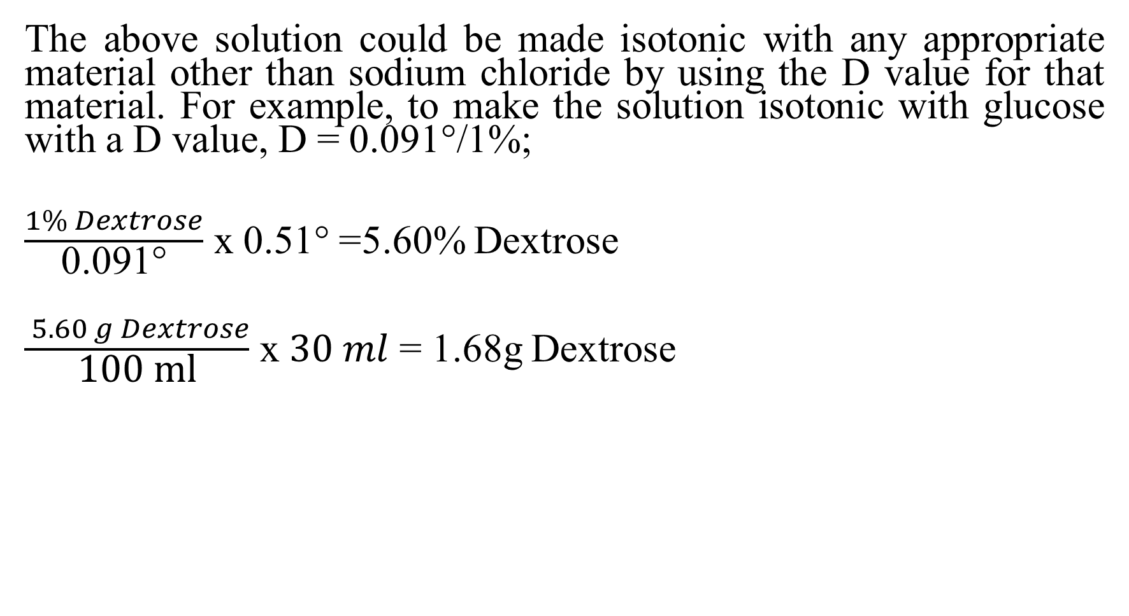
The above solution could be made isotonic with any appropriate material other than sodium chloride by using the D value for that material. For example, to make the solution isotonic with glucose with a D value, D = 0.091°/1%;
$\frac{1\% Dextrose}{\text{0.}\text{091}\text{°}}$ x $\text{0.5}\text{1}\text{°}$ =5.60% Dextrose
$\frac{ 5.60 g Dextrose}{\text{100 }\text{ml}}$ x $30 ml$ = 1.68g Dextrose

Slide 71
FPD (Δ T) value as given in table means 1% of drug solution causes this much of depression in freezing point.
As freezing point of blood or other isotonic solution is 0.52 so we can calculate % amount of drug which will cause FPD of 0.52 (means this solution will be isotonic)
For example if 1% of drug cause FPD of 0.3 ((Δ T=0.3) then x % will cause a depression of 0.52
X= (0.52/Δ T) 1% = 0.52/0.3= 1.73
i.e 1.73 % of this drug will be isotonic.
For dextrose Δ T=0.1, i.e. 1% dextrose causes FPD of 0.1
% of dextrose which will be isotonic?
X= (0.52/Δ T) 1% = 0.52/0.1= 5.2% dextrose.

Slide 72
Sodium Chloride Equivalent Method
A sodium chloride equivalent, E value, is defined as the weight of sodium chloride that will produce the same osmotic effect as 1 g of the drug.
For example, dexamethasone sodium phosphate has an E value of 0. 18 g NaCl/g drug at 0.5% drug concentration, 0.17 g NaCl/g drug at 1% drug concentration and a value of 0.16 g NaCl/g drug at 2% drug. This slight variation in the sodium chloride equivalent with concentration is due to changes in interionic attraction at different concentration of drug; the E value is not directly proportional to concentration, as was the freezing-point-depression.

Slide 73
The reference solution for the sodium chloride equivalent method is 0.9% sodium chloride, as it was for the freezing-point depression method. The dexamethasone sodium phosphate solution can be rendered isotonic, using the sodium chloride equivalent method as follows:
Dexamethasone Sodium Phosphate………..0.1%
Purified Water qs …………………………..30 ml

Slide 74
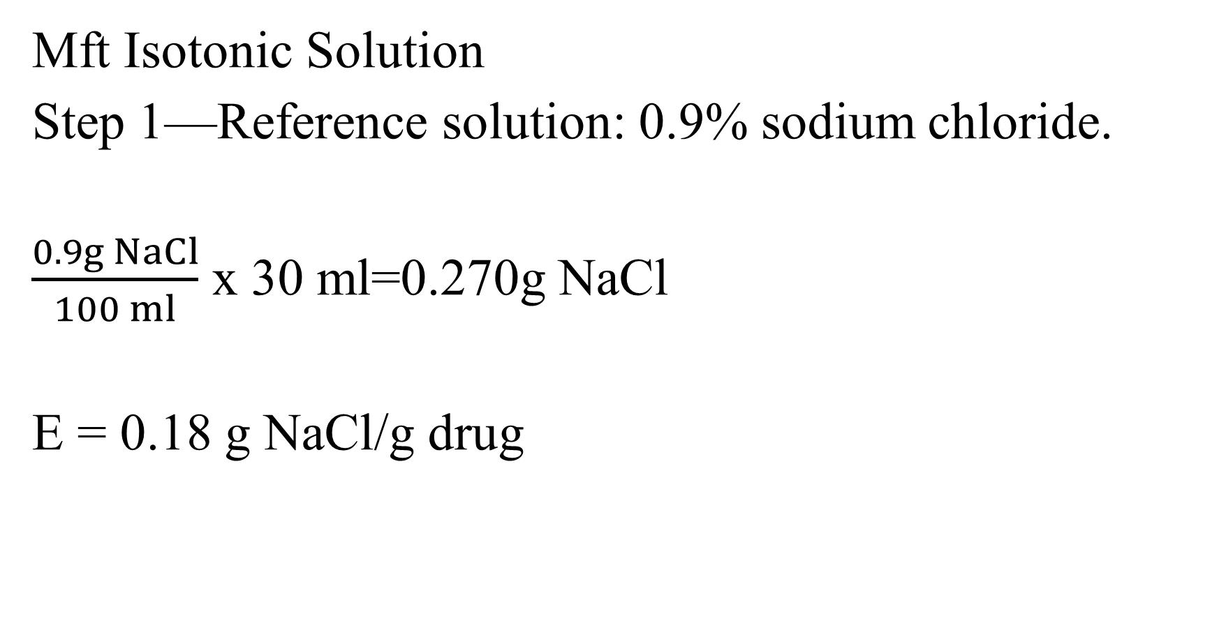
Mft Isotonic Solution
Step 1—Reference solution: 0.9% sodium chloride.
$\frac{0.9g NaCl}{100 ml}$ x 30 ml=0.270g NaCl
E = 0.18 g NaCl/g drug

Slide 75
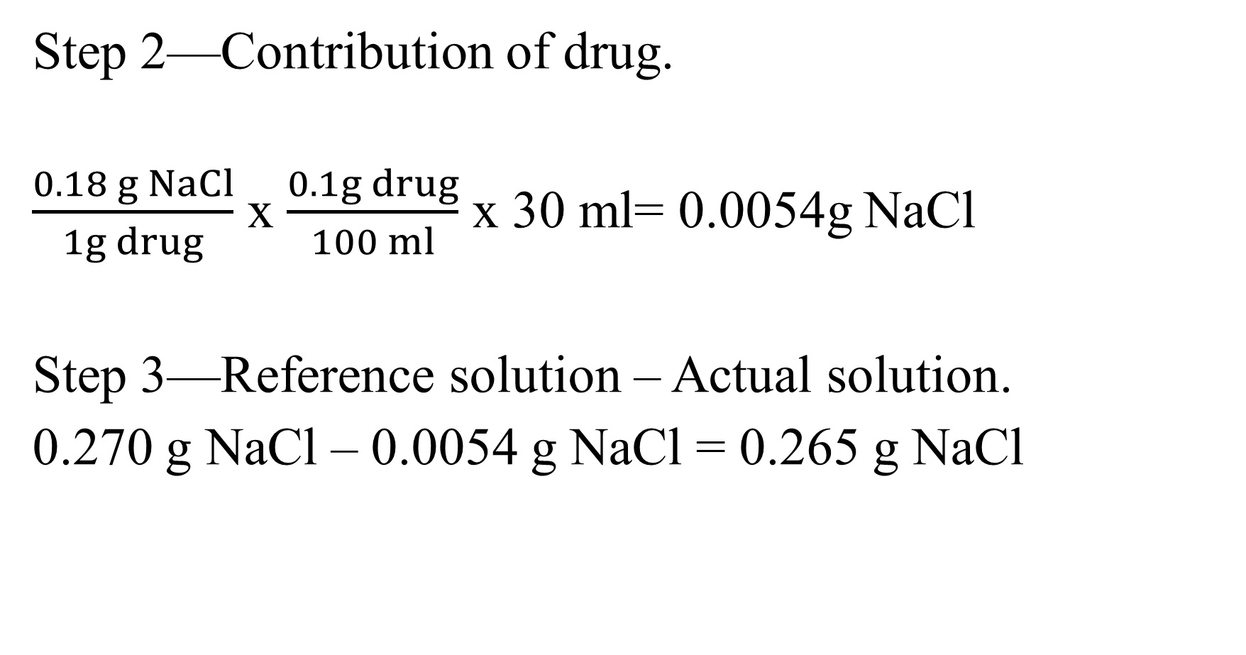
Step 2—Contribution of drug.
$\frac{0.18 g NaCl}{1g drug}$ x $\frac{0.1g drug}{100 ml}$ x 30 ml= 0.0054g NaCl
Step 3—Reference solution – Actual solution.
0.270 g NaCl – 0.0054 g NaCl = 0.265 g NaCl

Slide 76
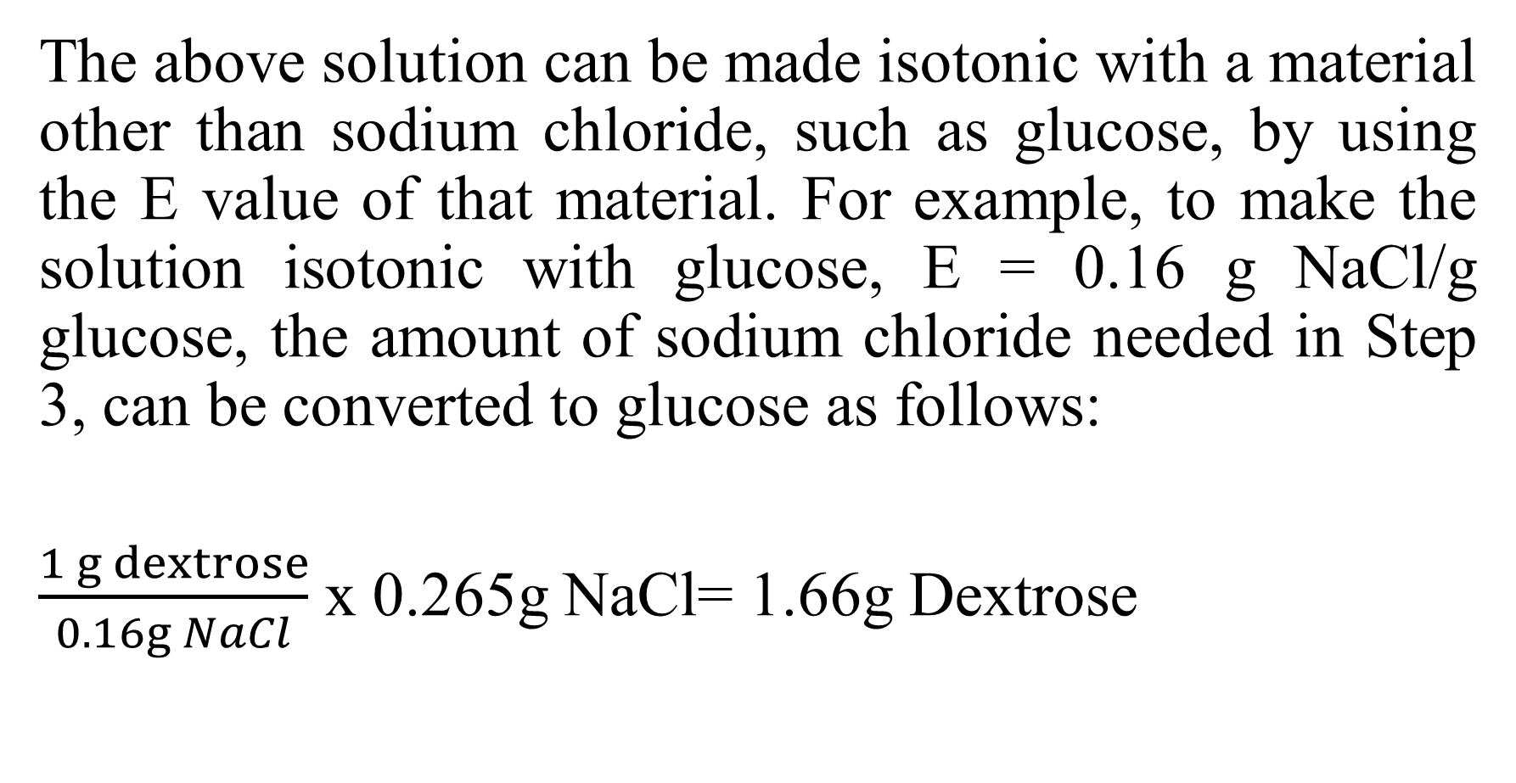
The above solution can be made isotonic with a material other than sodium chloride, such as glucose, by using the E value of that material. For example, to make the solution isotonic with glucose, E = 0.16 g NaCl/g glucose, the amount of sodium chloride needed in Step 3, can be converted to glucose as follows:
$\frac{1 g dextrose}{0.16g NaCl}$ x 0.265g NaCl= 1.66g Dextrose

Slide 77
Acid dissociation constant
An acid dissociation constant, K_{a}, (also known as acidity constant, or acid-ionization constant) is a quantitative measure of the strength of an acid in solution.
Acids and bases commonly are classified as strong or weak acids and strong or weak bases depending on whether they are ionized extensively or slightly in aqueous solutions.

Slide 78
If, for example, 1 N aqueous solutions of hydrochloric acid and acetic acid are compared, it is found that the former is a better conductor of electricity, reacts much more readily with metals, catalyzes certain reactions more efficiently, and possesses a more acid taste than the latter.

Slide 79
Both solutions, however, will neutralize identical amounts of alkali. A similar comparison of 1 N solutions of sodium hydroxide and ammonia reveals the former to be more active than the latter, although both solutions will neutralize identical quantities of acid.
The ionization of incompletely ionized acids may be considered a reversible reaction of the type.
HA H⁺ + A⁻

Slide 80
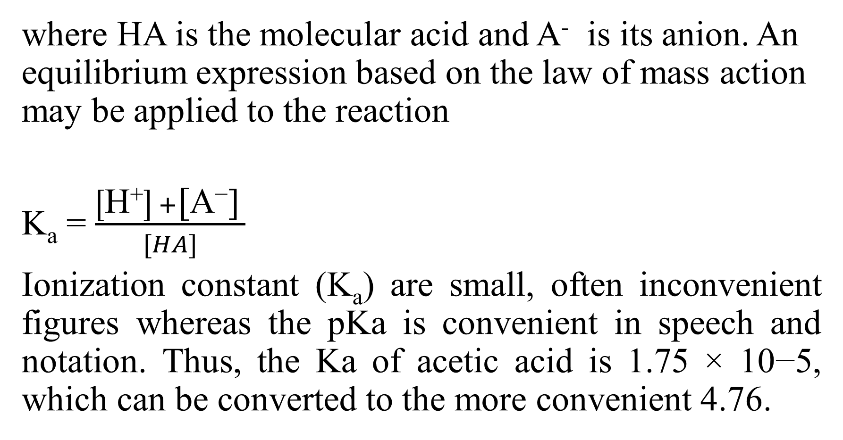
where HA is the molecular acid and A⁻ is its anion. An equilibrium expression based on the law of mass action may be applied to the reaction
K_{a} = $\frac{\left[\text{H}\text{+}\right] +\text{[}\text{A}\text{−}\text{]} }{[HA]}$
Ionization constant (K_{a}) are small, often inconvenient figures whereas the pKa is convenient in speech and notation. Thus, the Ka of acetic acid is 1.75 × 10−5, which can be converted to the more convenient 4.76.

Slide 81
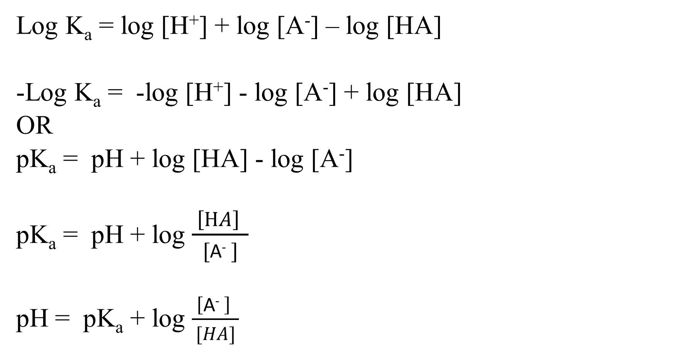
Log K_{a} = log [H⁺] + log [A⁻] – log [HA]
-Log K_{a} = -log [H⁺] - log [A⁻] + log [HA]
OR
pK_{a} = pH + log [HA] - log [A⁻]
pK_{a} = pH + log $\frac{ \left[HA\right] }{[\text{A}\text{−} ]}$
pH = pK_{a} + log $\frac{ \left[\text{A}\text{−} \right] }{[HA]}$

Slide 82
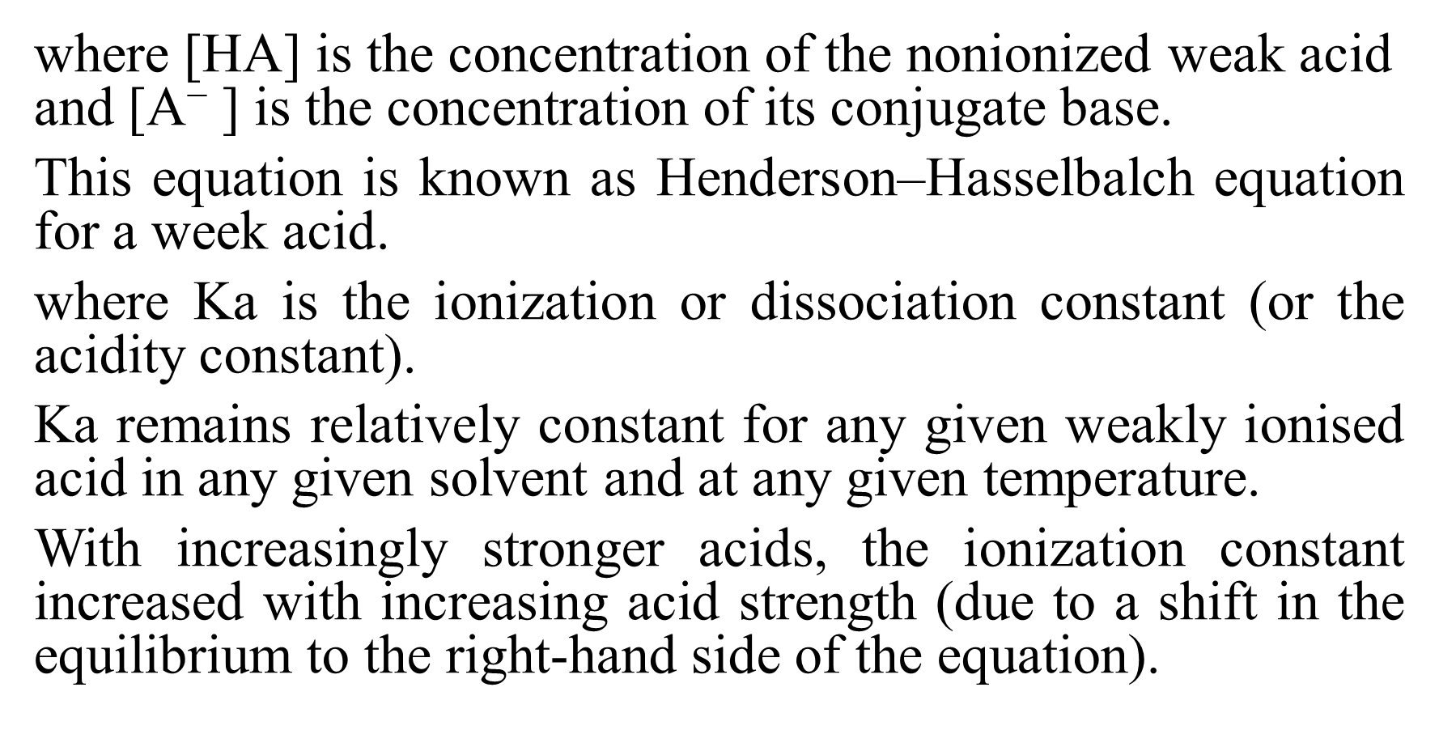
where [HA] is the concentration of the nonionized weak acid and [$\text{A}\text{−}$] is the concentration of its conjugate base.
This equation is known as Henderson–Hasselbalch equation for a week acid.
where Ka is the ionization or dissociation constant (or the acidity constant).
Ka remains relatively constant for any given weakly ionised acid in any given solvent and at any given temperature.
With increasingly stronger acids, the ionization constant increased with increasing acid strength (due to a shift in the equilibrium to the right-hand side of the equation).

Slide 83
Ionization of bases
The protonation of a weakly basic drug B is represented by
B+ H⁺ BH⁺
The acid dissociation constant of a protonated base is represented by

Slide 84

K_{a} = $\frac{\left[\text{H}\text{+}\right] +\text{[}\text{B}\text{]} }{\left[\text{B}\text{H}\text{+}\right]}$
Or
Log K_{a} = log [H⁺] + log [B] – log [$\text{B}\text{H}\text{+}$]
-Log K_{a} = -log [H⁺] - log [B] + log [$\text{B}\text{H}\text{+}$]

Slide 85

pK_{a} = pH + log [$\text{B}\text{H}\text{+}$] - log [B]
pK_{a} = pH + log $\frac{ \left[\text{B}\text{H}\text{+}\right] }{\text{[}\text{B}\text{]}}$
pH = pK_{a} + log $\frac{\text{[}\text{B}\text{]}}{[\text{B}\text{H}\text{+}]}$

Slide 86
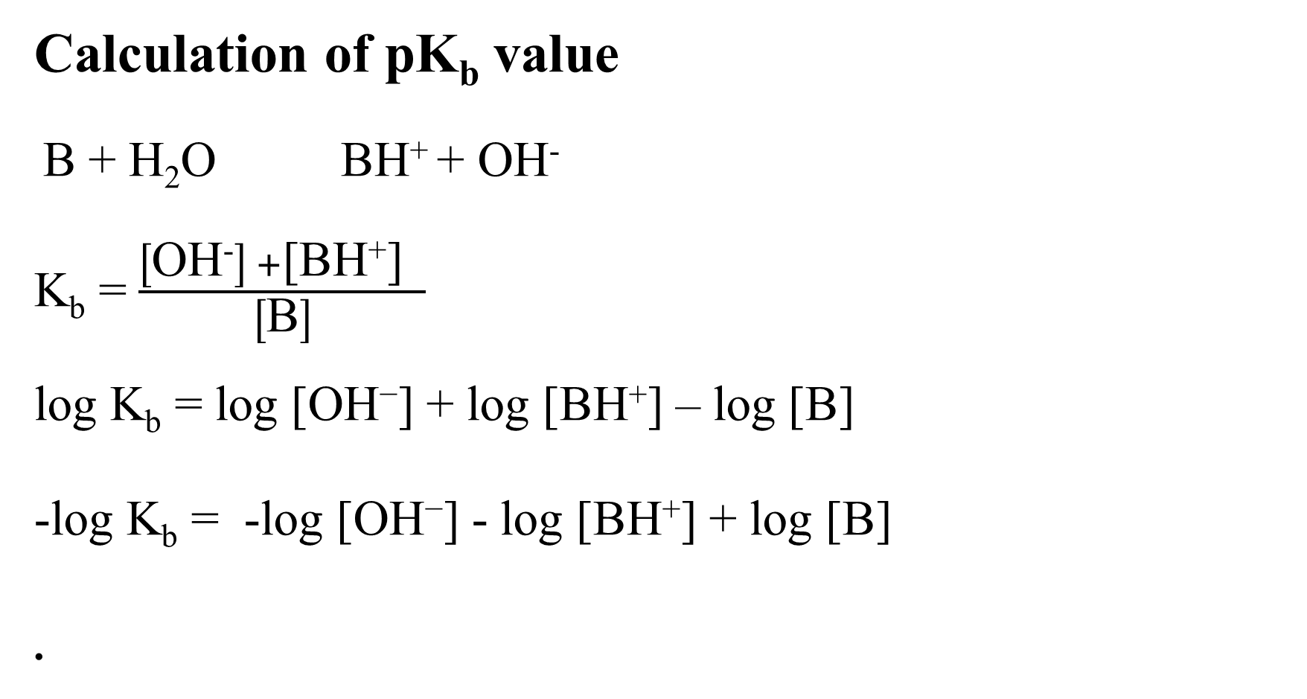
Calculation of pK_{b} value
B + H₂O BH⁺ + OH⁻
K_{b} = $\frac{\left[\text{OH}\text{−}\right] +\text{[}\text{BH}\text{+}\text{]} }{\left[\text{B}\right]}$
log K_{b} = log [$\text{OH}\text{−}$] + log [$\text{BH}\text{+}$] – log [B]
-log K_{b} = -log [$\text{OH}\text{−}$] - log [$\text{BH}\text{+}$] + log [B]

Slide 87

pK_{b} = pOH + log $\frac{\left[\text{B}\right]}{[\text{BH}\text{+}]}$
pOH = pK_{b} + log $\frac{ \left[\text{BH}\text{+}\right] }{\left[\text{B}\right]}$
pH + pOH = pK_{w}
pOH= pK_{w}- pH

Slide 88

As
pK_{b} = pOH + log $\frac{\left[\text{B}\right]}{[\text{BH}\text{+}]}$
pK_{b} = pK_{w}- pH + log $\frac{\left[\text{B}\right]}{[\text{BH}\text{+}]}$
pH = pK_{w}- pK_{b} + log $\frac{\left[\text{BH}\text{+} \right]}{[\text{B}]}$

Slide 89
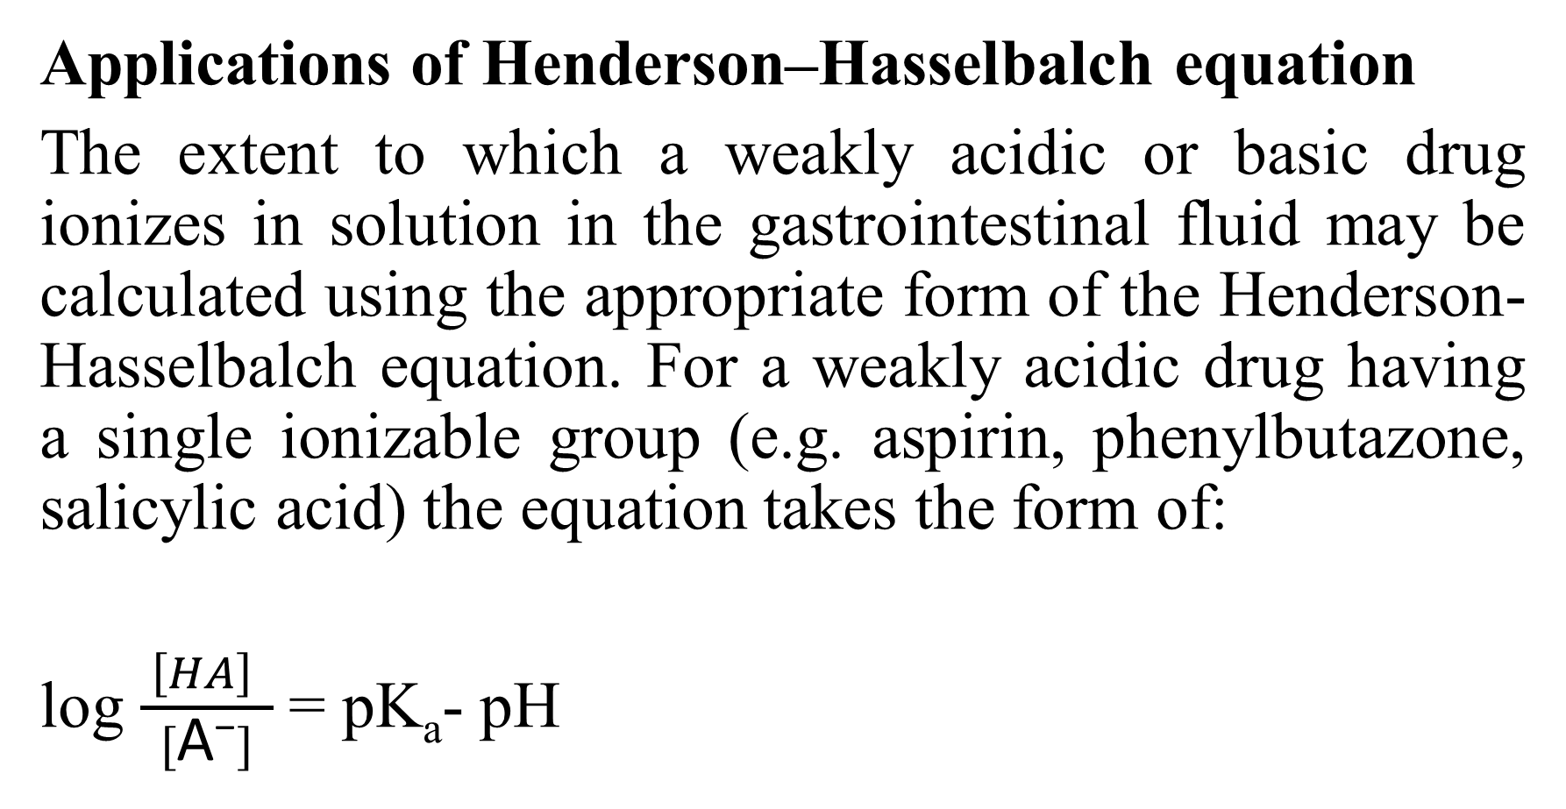
Applications of Henderson–Hasselbalch equation
The extent to which a weakly acidic or basic drug ionizes in solution in the gastrointestinal fluid may be calculated using the appropriate form of the Henderson-Hasselbalch equation. For a weakly acidic drug having a single ionizable group (e.g. aspirin, phenylbutazone, salicylic acid) the equation takes the form of:
log $\frac{ \left[HA\right] }{[\text{A}\text{−}]}$= pK_{a}- pH

Slide 90
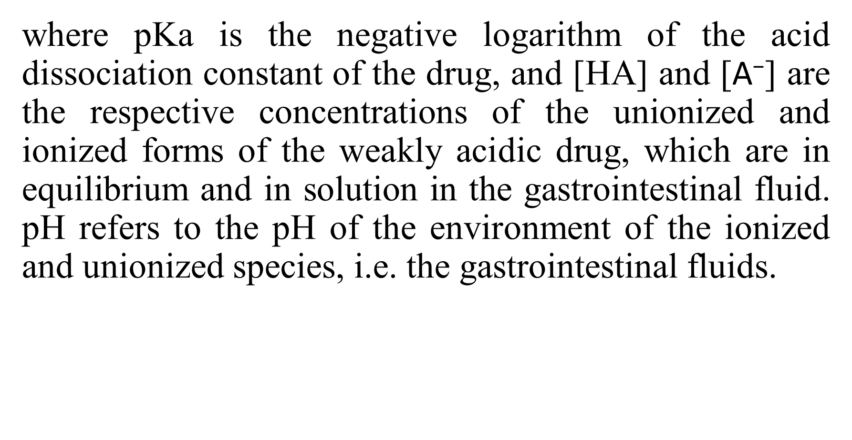
where pKa is the negative logarithm of the acid dissociation constant of the drug, and [HA] and [$\text{A}\text{−}$] are the respective concentrations of the unionized and ionized forms of the weakly acidic drug, which are in equilibrium and in solution in the gastrointestinal fluid. pH refers to the pH of the environment of the ionized and unionized species, i.e. the gastrointestinal fluids.

Slide 91
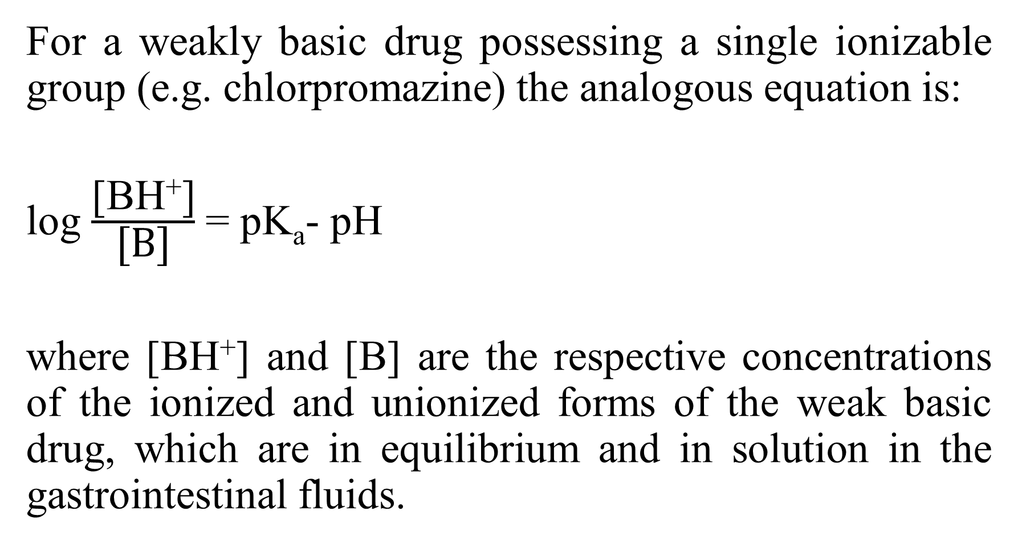
For a weakly basic drug possessing a single ionizable group (e.g. chlorpromazine) the analogous equation is:
log $\frac{\text{[}\text{B}\text{H}\text{+}\text{]}}{\text{[}\text{B}\text{]}}$ = pK_{a}- pH
where [$\text{B}\text{H}\text{+}$] and [B] are the respective concentrations of the ionized and unionized forms of the weak basic drug, which are in equilibrium and in solution in the gastrointestinal fluids.

Slide 92
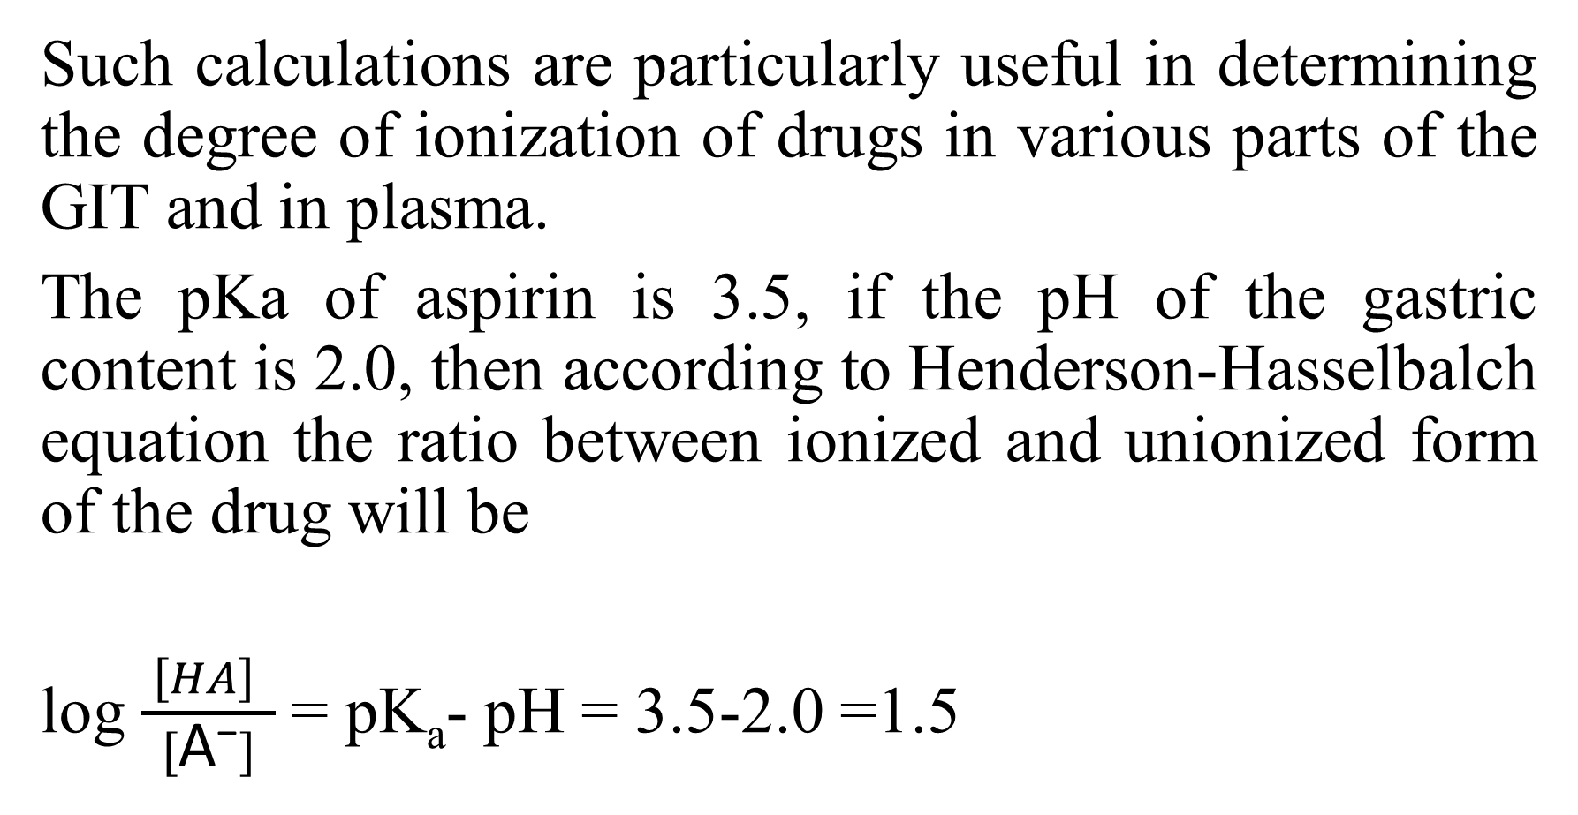
Such calculations are particularly useful in determining the degree of ionization of drugs in various parts of the GIT and in plasma.
The pKa of aspirin is 3.5, if the pH of the gastric content is 2.0, then according to Henderson-Hasselbalch equation the ratio between ionized and unionized form of the drug will be
log $\frac{ \left[HA\right] }{[\text{A}\text{−}]}$= pK_{a}- pH = 3.5-2.0 =1.5

Slide 93
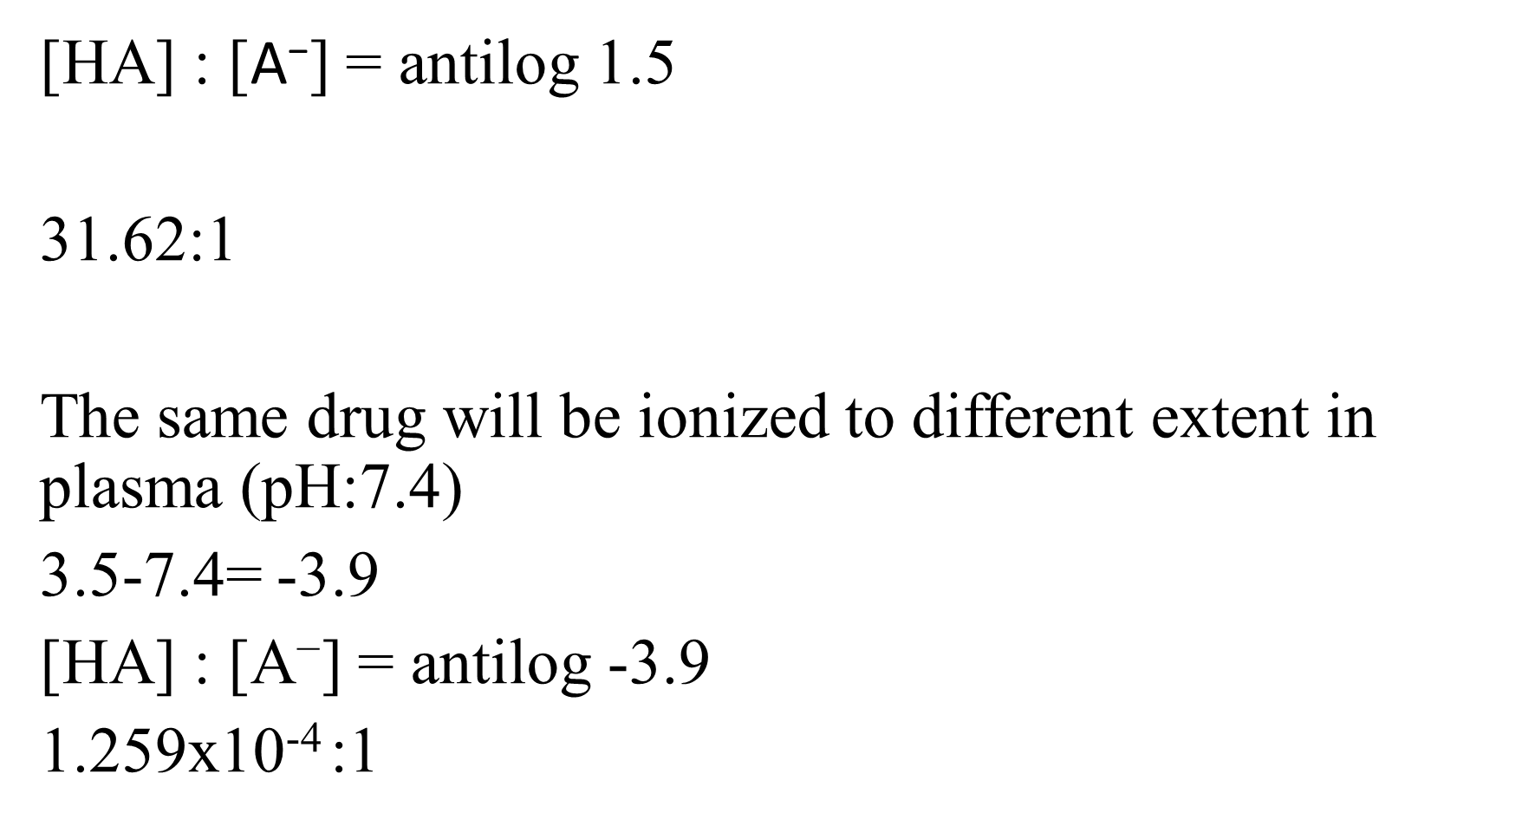
[HA] : [$\text{A}\text{−}$] = antilog 1.5
31.62:1
The same drug will be ionized to different extent in plasma (pH:7.4)
3.5-7.4= -3.9
[HA] : [$\text{A}\text{−}$] = antilog -3.9
1.259x10⁻⁴ :1

Slide 94
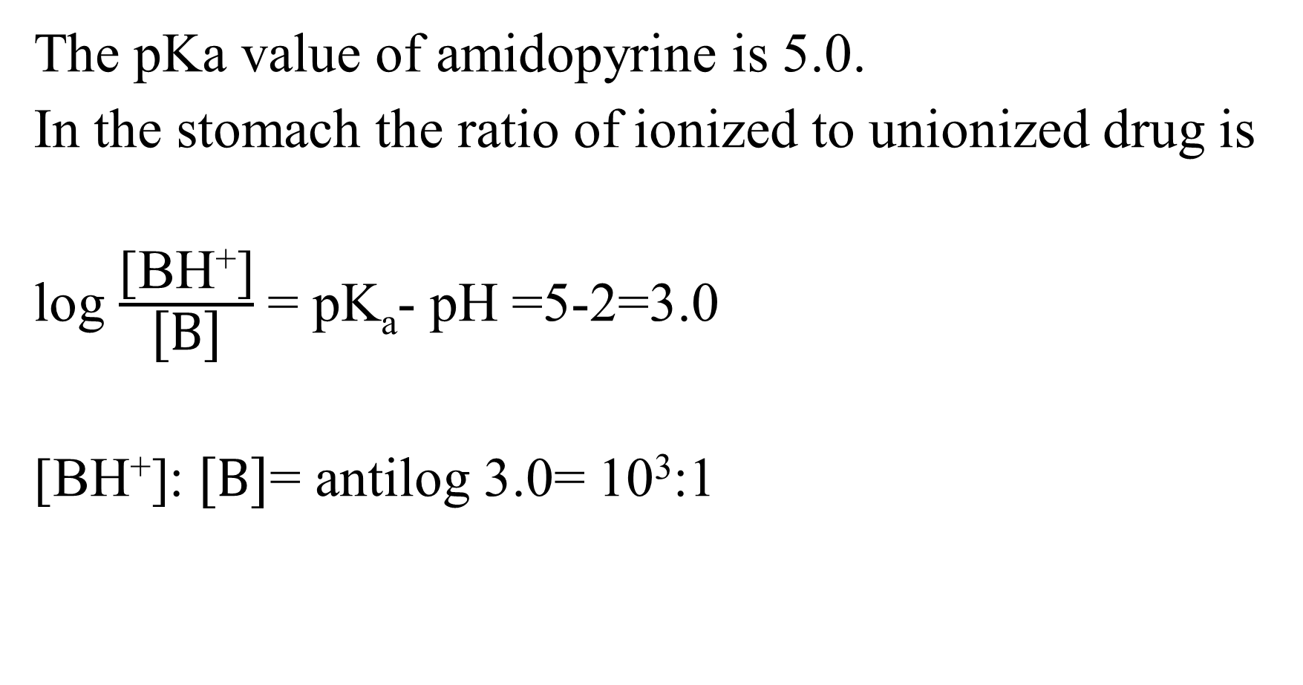
The pKa value of amidopyrine is 5.0.
In the stomach the ratio of ionized to unionized drug is
log $\frac{\text{[}\text{B}\text{H}\text{+}\text{]}}{\text{[}\text{B}\text{]}}$ = pK_{a}- pH =5-2=3.0
$\text{[}\text{B}\text{H}\text{+}\text{]}$: $\text{[}\text{B}\text{]}$= antilog 3.0= 10³:1

Slide 95
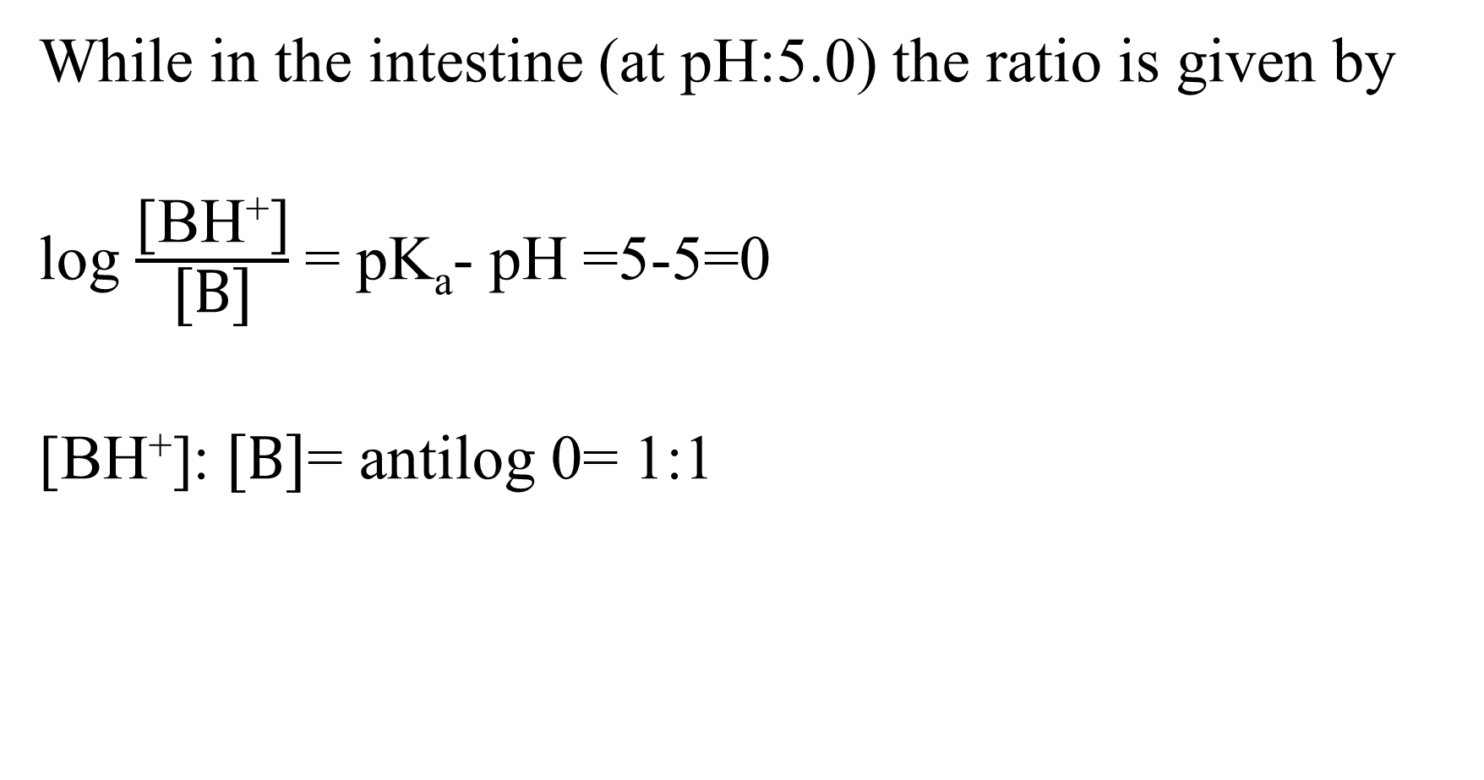
While in the intestine (at pH:5.0) the ratio is given by
log $\frac{\text{[}\text{B}\text{H}\text{+}\text{]}}{\text{[}\text{B}\text{]}}$ = pK_{a}- pH =5-5=0
$\text{[}\text{B}\text{H}\text{+}\text{]}$: $\text{[}\text{B}\text{]}$= antilog 0= 1:1

Slide 96
Therefore, according to these equations a weakly acidic drug, will be predominantly unionized in gastric fluid at and almost totally ionized in intestinal fluid, whereas a weakly basic drug, will be almost entirely ionized at gastric pH and predominantly unionized at intestinal pH. This means that, according to the pH-partition hypothesis, a weakly acidic drug is more likely to be absorbed from the stomach where it is unionized, and a weakly basic drug from the intestine where it is predominantly unionized. However, in practice, other factors need to be taken into consideration.

Slide 97
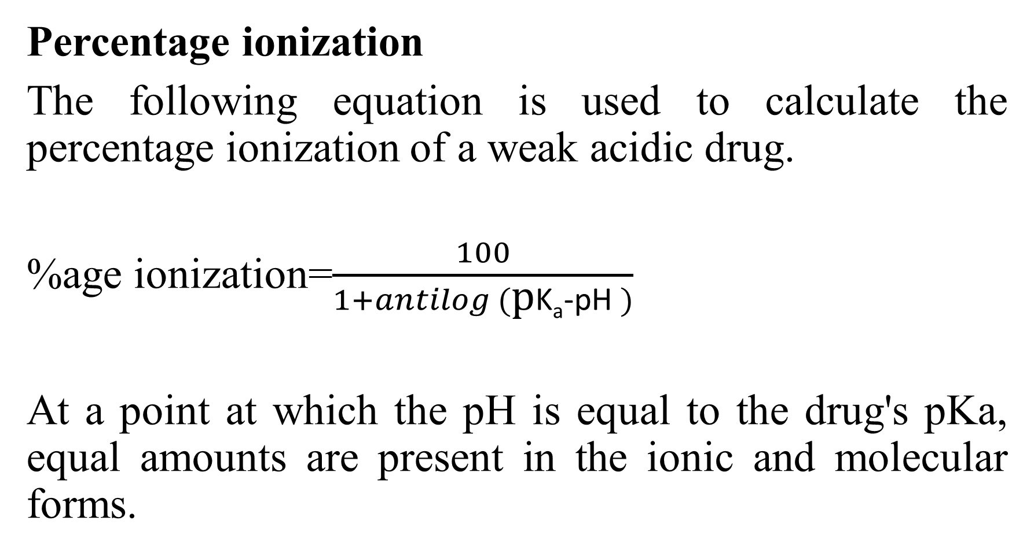
Percentage ionization
The following equation is used to calculate the percentage ionization of a weak acidic drug.
%age ionization=$\frac{100}{1+antilog (\text{p}\text{K}\text{a}\text{−}\text{p}\text{H} )}$
At a point at which the pH is equal to the drug's pKa, equal amounts are present in the ionic and molecular forms.

Slide 98
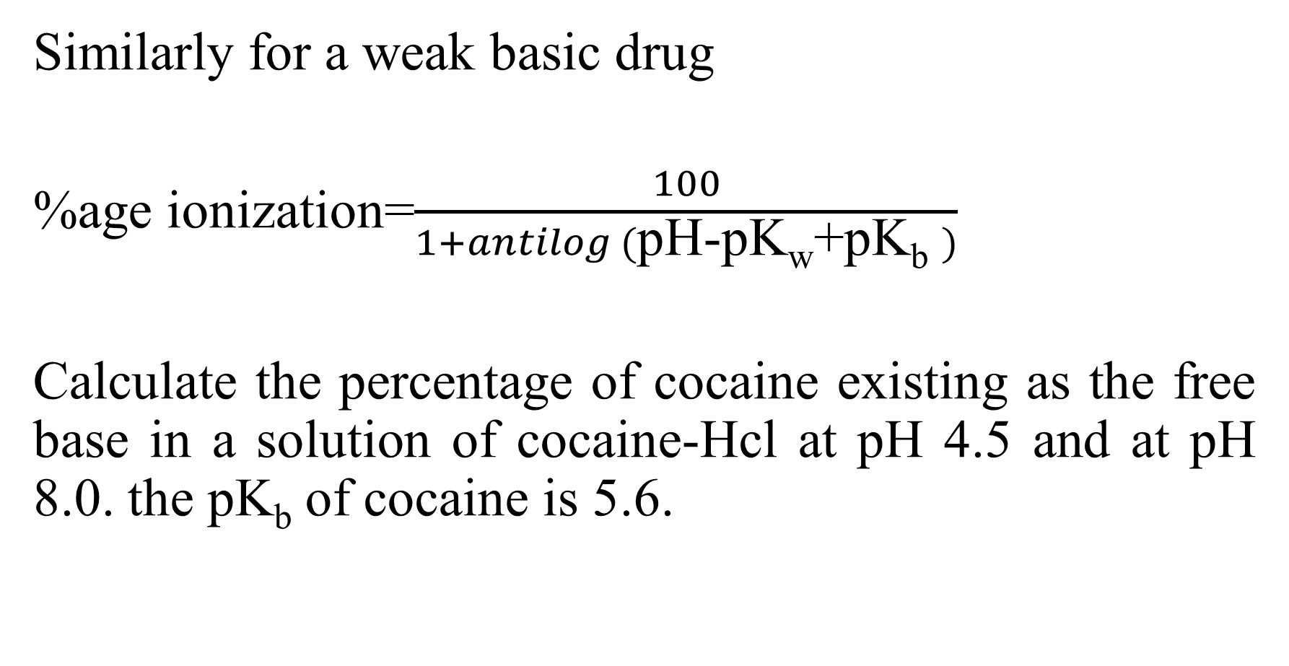
Similarly for a weak basic drug
%age ionization=$\frac{100}{1+antilog (\text{pH}\text{−}\text{pKw}\text{+}\text{pKb} )}$
Calculate the percentage of cocaine existing as the free base in a solution of cocaine-Hcl at pH 4.5 and at pH 8.0. the pK_{b} of cocaine is 5.6.

Slide 99
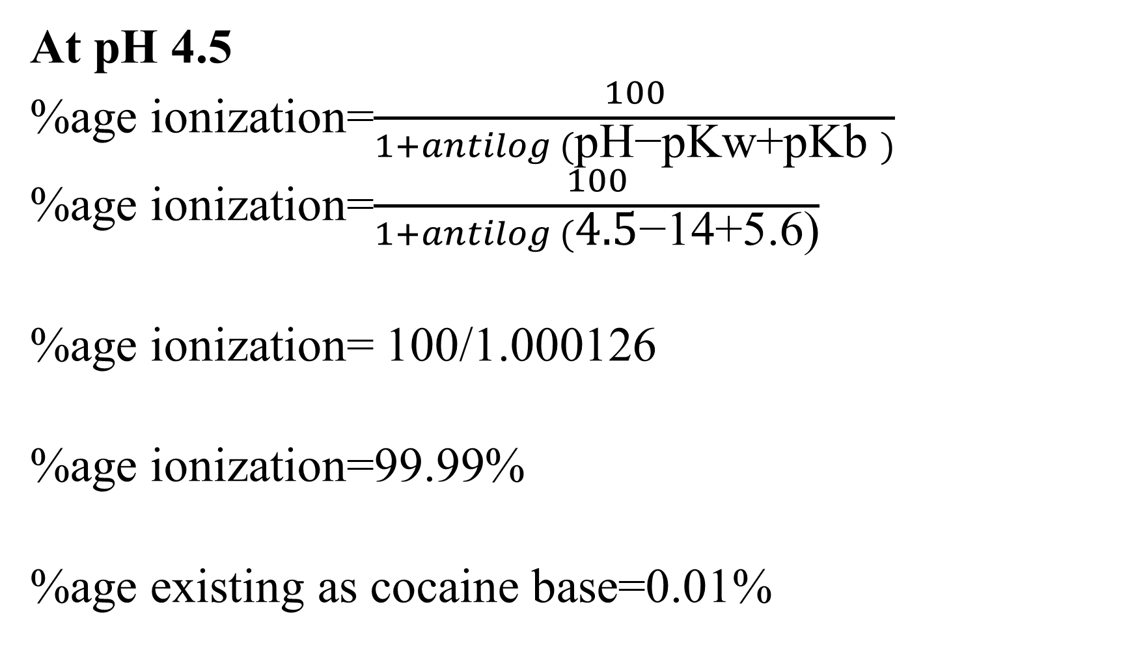
At pH 4.5
%age ionization=$\frac{100}{1+antilog (\text{pH}\text{−}\text{pKw}\text{+}\text{pKb} )}$
%age ionization=$\frac{100}{1+antilog (\text{4.5}\text{−}\text{14+5.6)}}$
%age ionization= 100/1.000126
%age ionization=99.99%
%age existing as cocaine base=0.01%

Slide 100
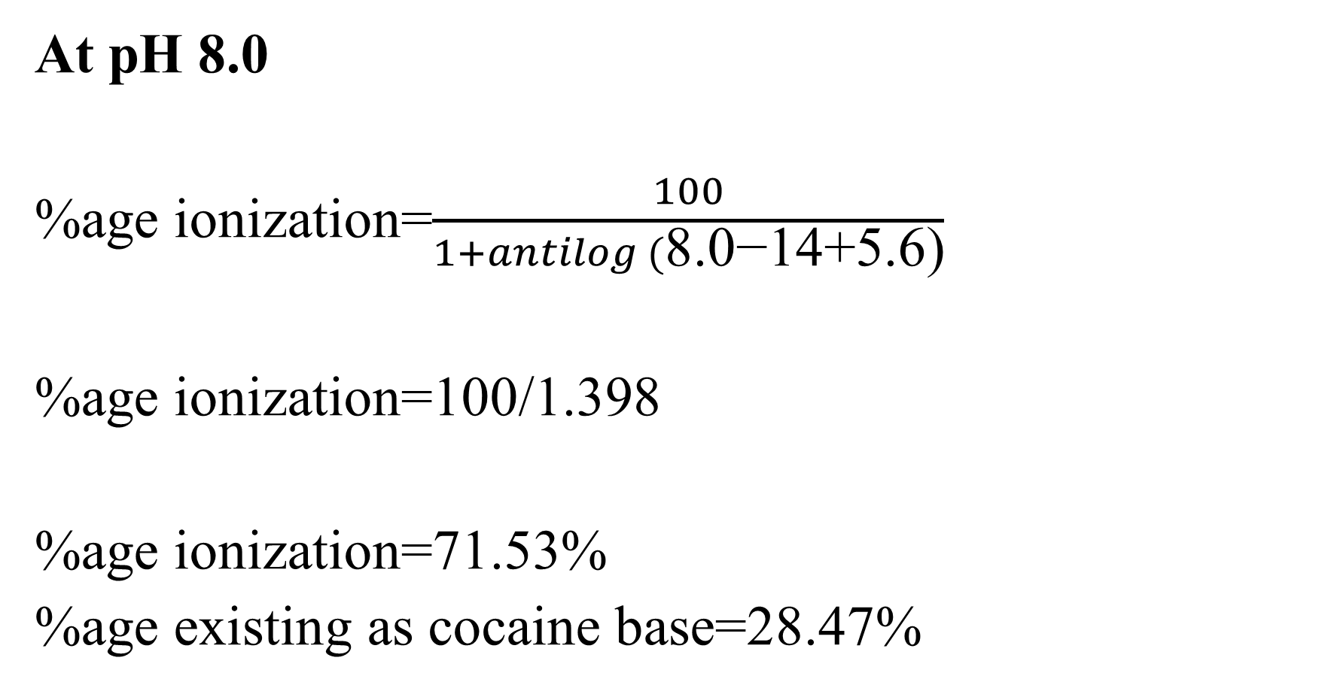
At pH 8.0
%age ionization=$\frac{100}{1+antilog (\text{8.0}\text{−14+5.6)}}$
%age ionization=100/1.398
%age ionization=71.53%
%age existing as cocaine base=28.47%

Slide 101
Relationship between pH, pKa, and solubility of weak acids and bases

Slide 102
When the pH of an aqueous solution of the weakly acidic drug approaches to within 2 pH units of the pKa there is a very pronounced change in the ionisation of that drug.
Weakly acidic drugs are virtually completely unionised at pH up to 2 units below their pKa and virtually completely ionised at pH greater than 2 units above their pKa. They are exactly 50% ionised at pH equal to their pKa values

Slide 103
Weakly basic drugs are virtually completely ionised at pH up to 2 units below their pKa and virtually completely unionised at pH greater than 2 units above their pKa. They are exactly 50% ionised at pH equal to their pKa values.

Slide 104
For weak acids:
pH = pKa compound is approximately 50% ionised
pH = pKa –1 compound is approximately 90% ionised
pH = pKa –2 compound is approximately 99% ionised
pH = pKa –3 compound is approximately 99.9% ionised
For weak bases:
pH = pKa compound is approximately 50% ionised
pH = pKa + 1 compound is approximately 90% ionised
pH = pKa + 2 compound is approximately 99% ionised
pH = pKa + 3 compound is approximately 99.9% ionised

